Slide 1
Knowledge-based recommenders
CS616

Slide 2


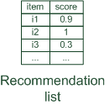




Knowledge-based recommendation
Knowledge-based: "Tell me what fits based on my needs"

Slide 3
Knowledge-based recommendation
Explicit domain knowledge
Sales knowledge elicitation from domain experts
System mimics the behavior of experienced sales assistant
Best-practice sales interactions
Can guarantee “correct” recommendations (determinism) with respect to expert knowledge
Conversational interaction strategy
Opposed to one-shot interaction
Elicitation of user requirements
Transfer of product knowledge (“educating users”)

Slide 4
Types
Different views on “knowledge”
Logic-based knowledge descriptions (from domain expert)
E.g. Hard and soft constraints
Utility-based RS
E.g. MAUT – Multi-attribute utility theory

Slide 5
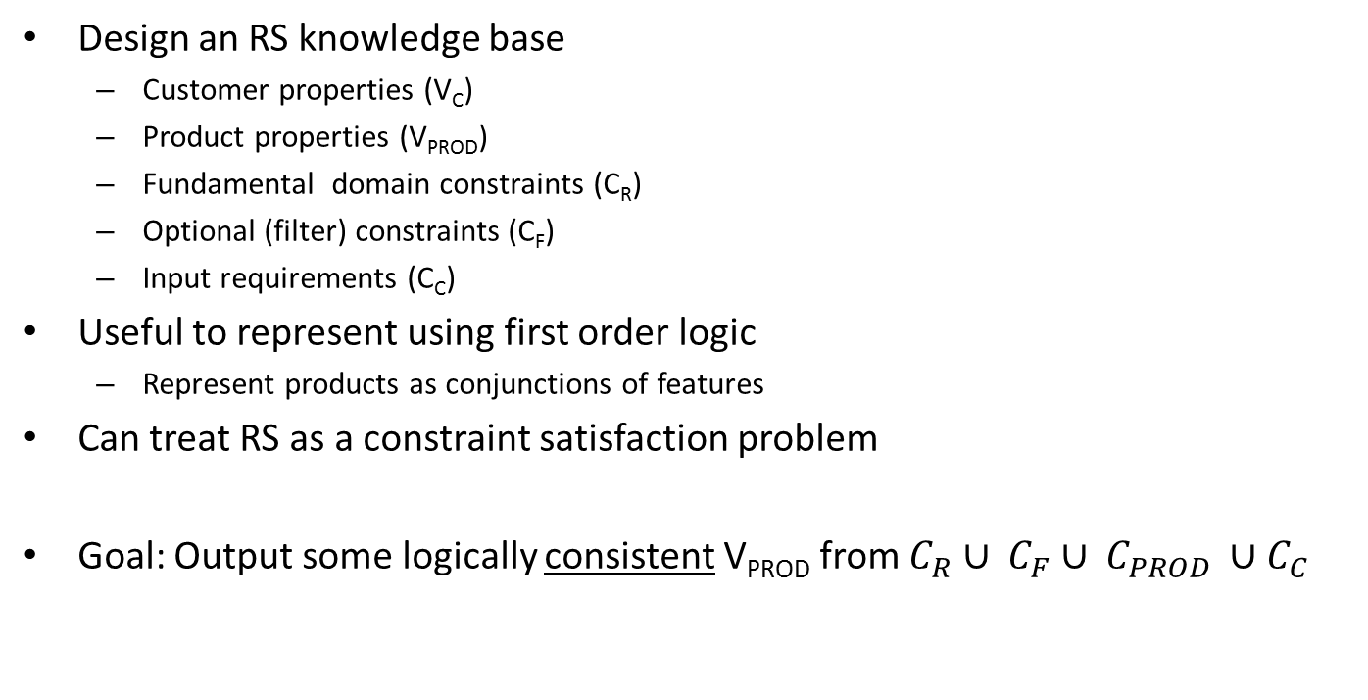

Logic-based knowledge base
Design an RS knowledge base
Customer properties (V_{C})
Product properties (V_{PROD})
Fundamental domain constraints (C_{R})
Optional (filter) constraints (C_{F})
Input requirements (C_{C})
Useful to represent using first order logic
Represent products as conjunctions of features
Can treat RS as a constraint satisfaction problem
Goal: Output some logically consistent V_{PROD} from $C_{R}∪ C_{F}∪ C_{PROD} ∪C_{C}$
$$CSP(V_{c}, V_{PROD}, C_{R}∪ C_{F}∪ C_{PROD} ∪C_{C})$$

Slide 6
Logical consistency check
A set of statements is logically consistent if they can all be simultaneously true
Shall we work through some examples?
I am a man. I have short hair. You have long hair. You are a woman.
Everyone should be tolerant because there is no way to judge another person's beliefs.
It is raining. It is not raining.
Light is simultaneously both a wave and a particle.
God can do anything.
This sentence is false.

Slide 7
Typical solution approaches
Backtracking
Recursive depth first search
Constraint propagation (e.g. AC-3)
Store arcs that represent constraints between variable pairs
Eliminate one variables possible values based on constraints
Iterate
Local search (e.g. min-conflicts)
Assign values to all variables
Pick a violating variable
Assign a value that minimizes conflicts for it
Iterate
Historically computationally complex, but recent work shows promise of scalability

Slide 8
Not well suited for
Situations with subjective preferences
Because of conjunction fallacies
Sharmishtha is 31 years old, single, outspoken, and very bright. She majored in philosophy. As a student, she was deeply concerned with issues of discrimination and social justice, and also participated in antiwar demonstrations.
Assign probabilities to the following sentences being true
She is an investment banker.
She is active in the feminist movement.
She is an investment banker and is active in the feminist movement.

Slide 9
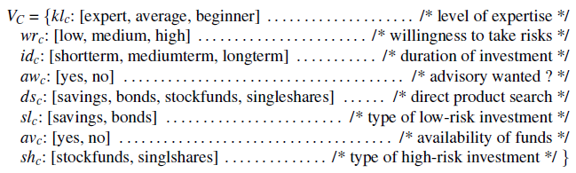
Sample constraint-based problem

Slide 10
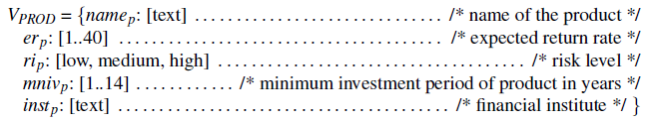

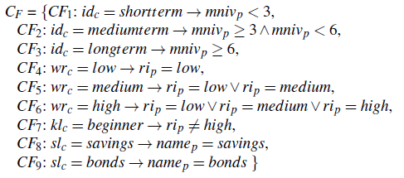

Slide 11

Logical product description
What will the RS output be?

Slide 12
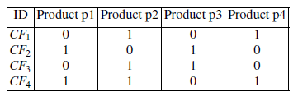
Query relaxation
What if no exact match is found?
Approach: find maximal subset of query that removes conflict
Naïve solution has exponential complexity
Can you design a better solution?
Iterate over products to find # relaxations needed to satisfy

Slide 13
Can also involve customer
Computation of minimal revisions of requirements
Do you want to relax your brand preference?
Accept Panasonic instead of Canon brand
Or is photographing landscapes with a wide-angle lens and maximum cost less important?
Lower focal length > 28mm and Price > 350 EUR
Optionally guided by some predefined weights or past community behavior
Be aware of possible biases (e.g. age, family status, …)

Slide 14
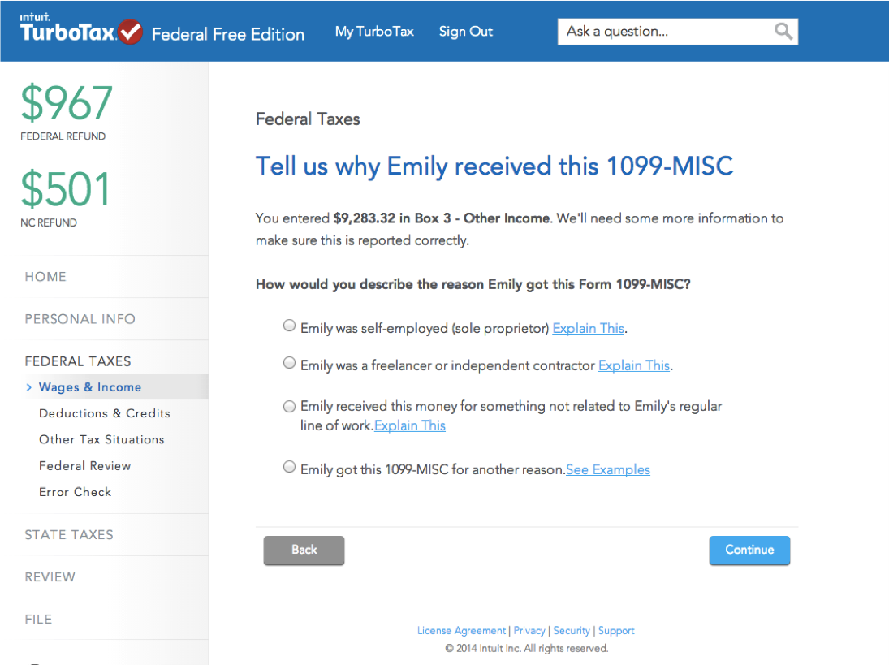
Use case

Slide 15
Best suited for
 | Low | Medium | High
Upfront cost |  |  | X
Error cost |  |  | X
Heterogeneity | X
Frequency | X
Scale |  |  | X

Slide 16
Utility-based knowledge bases
Multi-Attribute Utility Theory (MAUT)
Each item is evaluated according to a predefined set of dimensions that provide an aggregated view on the basic item properties
E.g. quality and economy are dimensions in the domain of digital cameras
id | value | quality | economy
price | ≤250 >250 | 5 10 | 10 5
mpix | ≤8 >8 | 4 10 | 10 6
opt-zoom | ≤9 >9 | 6 10 | 9 6
... | ... | ... | ...

Slide 17
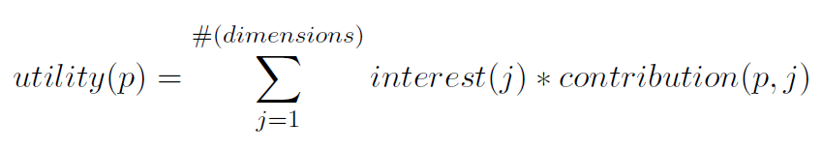
Customer-item utilities with MAUT
Customer interests:
Item utilities:
customer | quality | economy
Cu₁ | 80% | 20%
Cu₂ | 40% | 60%
*
quality | economy | utility: cu₁ | utility: cu₂
P1 Σ(5,4,6,6,3,7,10) = 41 | Σ (10,10,9,10,10,10,6) = 65 | 45.8 [8] | 55.4 [6]
P2 Σ(5,4,6,6,10,10,8) = 49 | Σ (10,10,9,10,7,8,10) = 64 | 52.0 [7] | 58.0 [1]
P3 Σ(5,4,10,6,10,10,8) = 53 | Σ (10,10,6,10,7,8,10) = 61 | 54.6 [5] | 57.8 [2]
... | ... | ... | ...
**
*
**
Output items ranked by utility

Slide 18
Constraint-based recommendation III
More variants of recommendation task
Customers may not know what they are seeking
Find "diverse" sets of items
Notion of similarity/dissimilarity
Idea that users navigate a product space
If recommendations are more diverse than users can navigate via critiques on recommended "entry points" more efficiently (less steps of interaction)
Bundling of recommendations
Find item bundles that match together according to some knowledge
E.g. travel packages, skin care treatments or financial portfolios
RS for different item categories, CSP restricts configuring of bundles

Slide 19
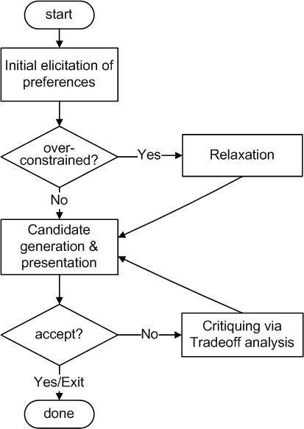
Conversational strategies
Process consisting of multiple conversational moves
Resembles natural sales interactions
Not all user requirements known beforehand
Customers are rarely satisfied with the initial recommendations
Different styles of preference elicitation:
Free text query interface
Asking technical/generic properties
Images / inspiration
Proposing and Critiquing

Slide 20
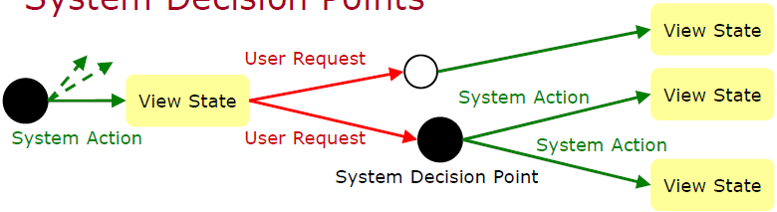
Example: adaptive strategy selection
State model, different actions possible
Propose item, ask user, relax/tighten result set,…
[Ricci et al., JITT, 2009]

Slide 21
Limitations of knowledge-based recommendation methods
Cost of knowledge acquisition
From domain experts
From users
Remedy: exploit web resources
Accuracy of preference models
Very fine granular preference models require many interaction cycles with the user or sufficient detailed data about the user
Remedy: use collaborative filtering, estimates the preference of a user
However: preference models may be instable
E.g. asymmetric dominance effects, conjunction effects, sunk cost effects

